Slide 1
Analysis of BC Aging with CAMChem Model
Yinrui Li
Department of Atmospheric Sciences
University of Illinois Urbana-Champaign

Slide 2
Outline
Model: cesm1_2_2_CAMChem
Compset: MAM4+chemistry (FSTRATMAM4).
Time period: year 2000
interactive meteorology field－online;
Emission:
Elevated: ar5_mam3_bc_elev_1850-2010_c20100902_v12.nc’
Surface: ar5_mam3_bc_surf_1850-2010_c20100902_v12.nc’
Spatial distribution of aerosol species;
Hygroscopicity for accumulation and primary carbon modes;
Sensitivity of MAM4 to aging criterion;
Diagnose aging timescales;
Notes:
CESM1_2_2_CAMChem is a special tag released for camchem users. Compset FSTRATMAM3 and FSTRATMAM4 are both based on F2000.

Slide 3
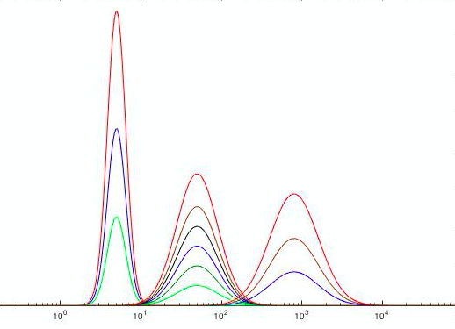
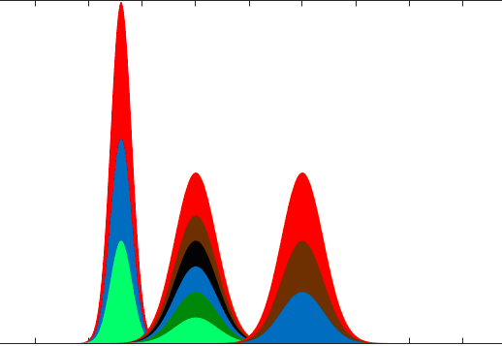
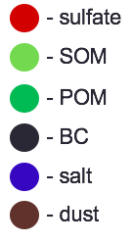
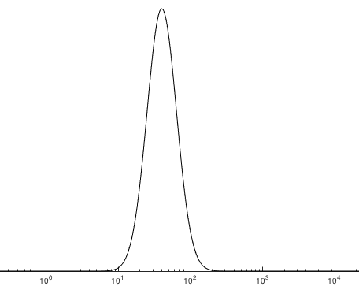
Background: schematic of aerosol modes and associated tracers in MAM4
MAM4 | σ_{g} | Size range (μm)
Aitken | 1.6 | 0.015-0.053
Accumulation | 1.8 | 0.058-0.27
Primary carbon | 1.6 | 0.039-0.13
Coarse | 1.8 | 0.80-3.65
aitken
accumulation
coarse
Coagulation
Condensation
(Liu et al., 2015)
Primary carbon mode
Notes:
A 4-mode version of the modal aerosol model (MAM4) is applied in CAMChem1.2.2. BC is emitted to the primary carbon mode, and then is aged and transferred to the accumulation mode by condensation of $\rm{H_2SO_4}$, $\rm{NH_3}$ and $\rm{SOA}$ and by coagulation (Liu et al., 2012).

Slide 4
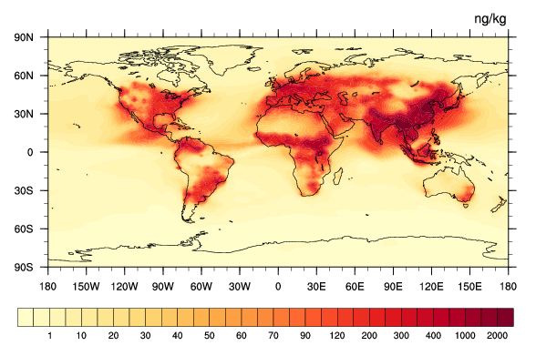
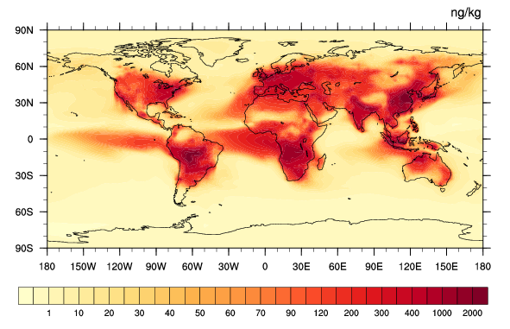
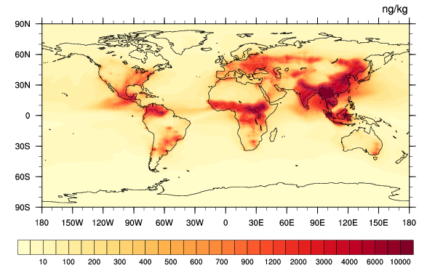
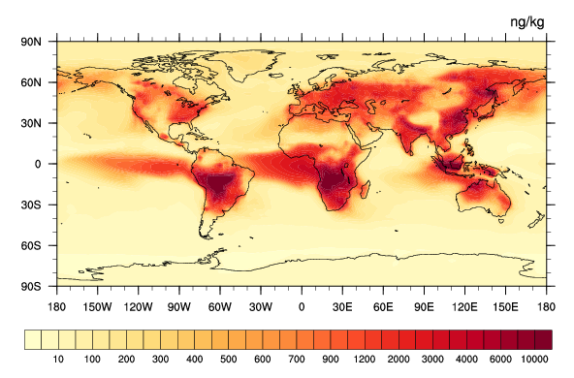
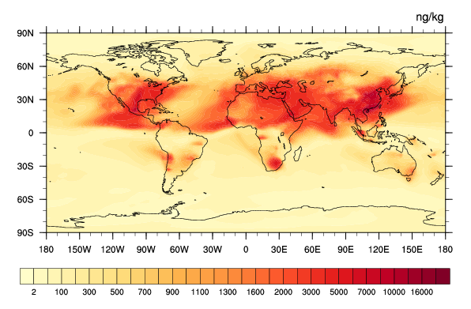
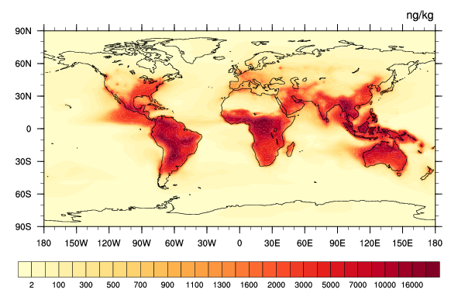
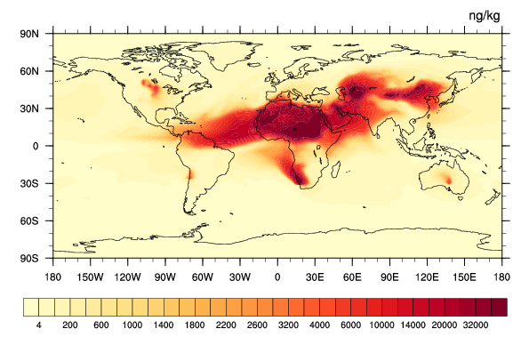
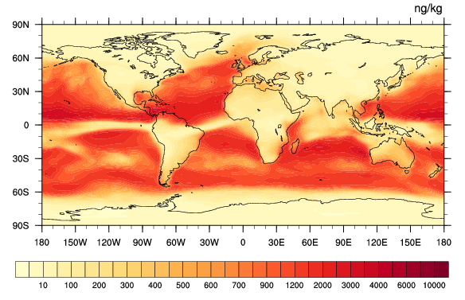
Black Carbon and Organic Carbon – 992hPa
BC - March BC - September
OC - March OC - September
Sulfate - March
SOA - March
Dust - March
Sea salt March
Notes:
Add March

Slide 5
Hygroscopicity (Kappa) for Accumulation Mode and Primary Carbon Mode
Accumulation mode: SO4, BC, OC, SOA, dust, sea salt.
P-carbon mode: BC, OC
Species | Density (kg/m3) | Kappa
NH₄SO₄ | 1800 | 0.61
BC | 1800 | 0.0
OC | 1000 | 0.001
SOA | 1400 | 0.1
dust | 2600 | 0.1
Sea salt | 2200 | 0.53

Slide 6
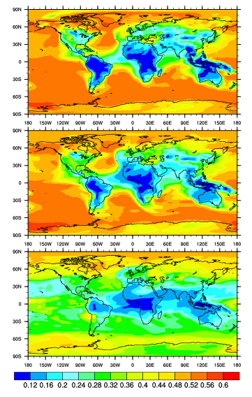
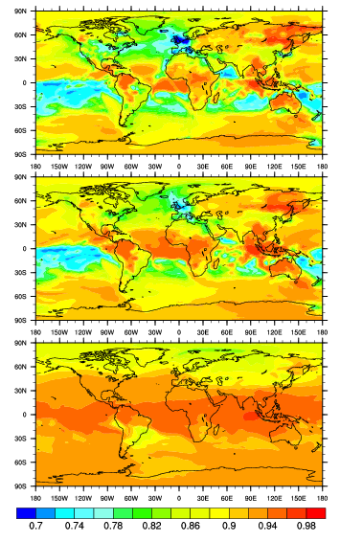
Hygroscopicity (Kappa) for March
Accumulation mode P-carbon mode
992hPa
859hPa
524hPa
Hygroscopicity of accumulation mode is dominated by sulfate/SOA over land and by sea salt over the ocean.
Two modes are very different indicating BC’s little contribution to accumulation mode.
(10^-3)

Slide 7
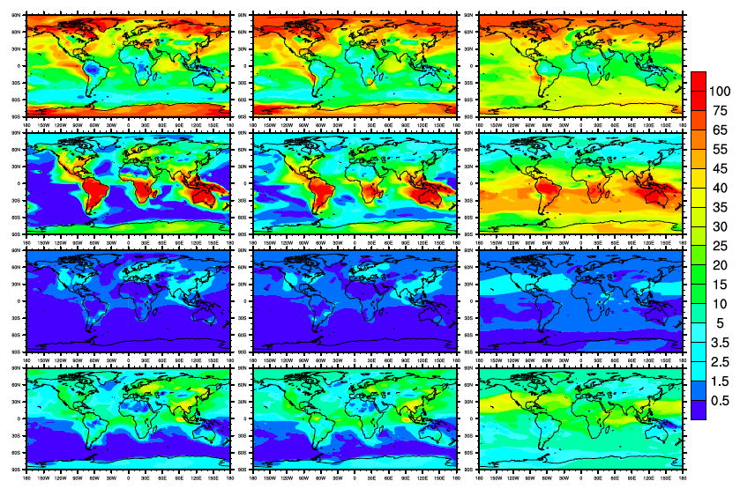
Composition - Accumulation Mode
992hPa 859hPa 524hPa
Sulfate
SOA
BC
OC
Volume fraction (%)

Slide 8
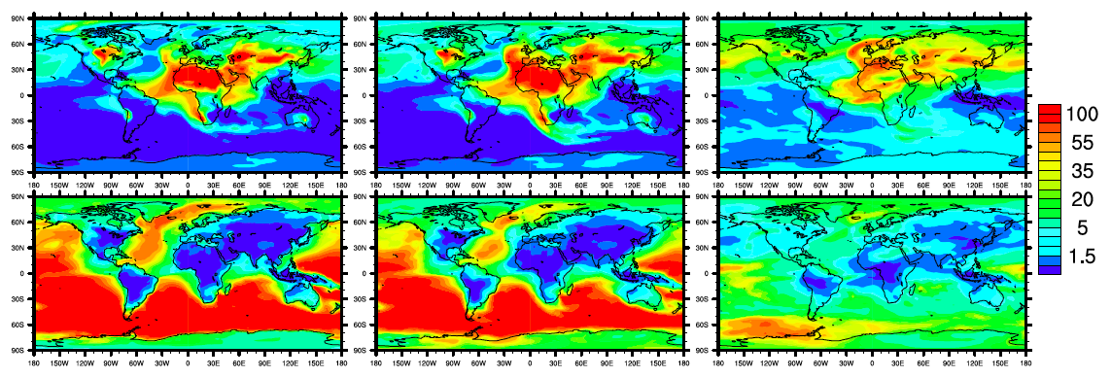
Composition - Accumulation Mode
992hPa 859hPa 524hPa
dst
sst
Volume fraction (%)

Slide 9
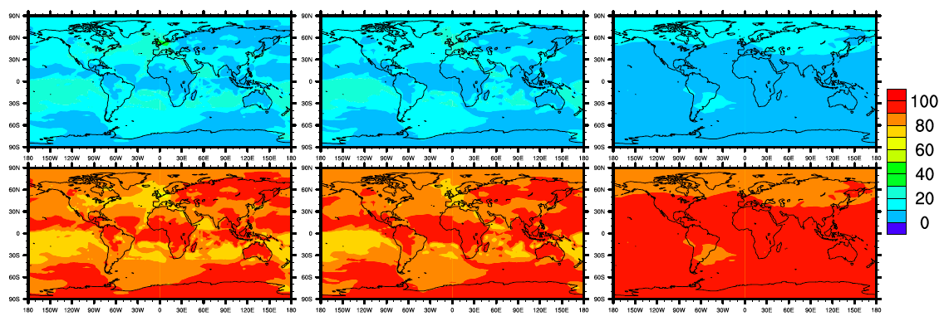
Composition - Primary Carbon Mode
992hPa 859hPa 524hPa
BC
OC
Volume fraction (%)

Slide 10
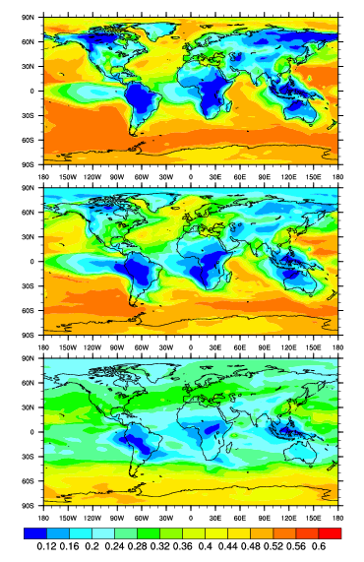
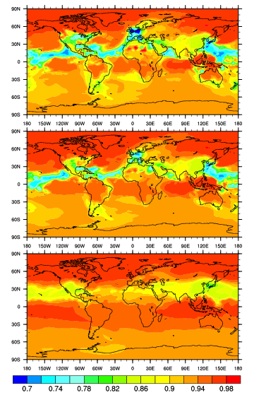
September
Accumulation mode P-carbon mode
992hPa
859hPa
524hPa
(10^-3)
Notes:
BC doesn’t play a dominating role for both mode.

Slide 11
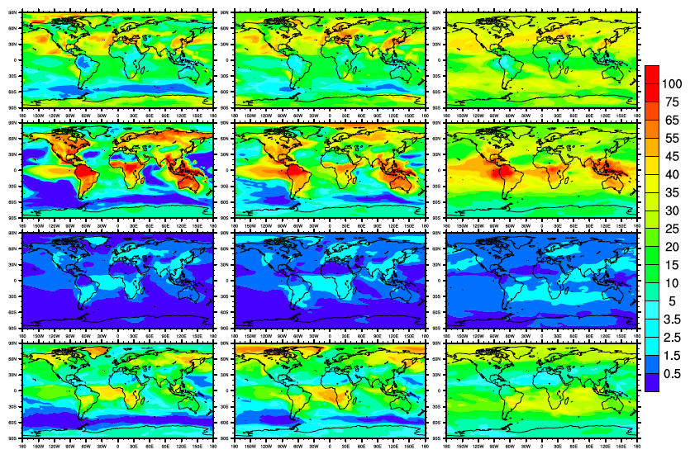
September
992hPa 859hPa 524hPa
Sulfate
SOA
BC
OC
Volume fraction (%)

Slide 12
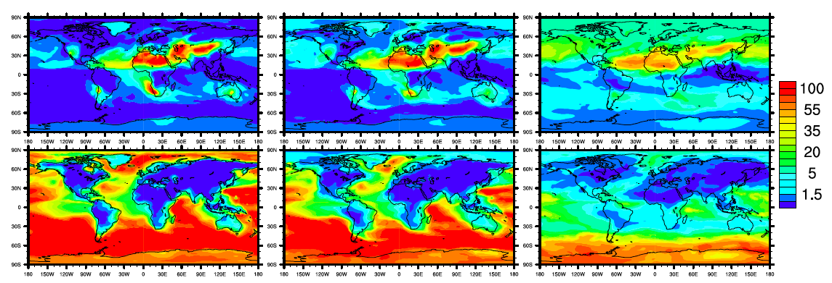
September
992hPa 859hPa 524hPa
dst
sst
Volume fraction (%)

Slide 13
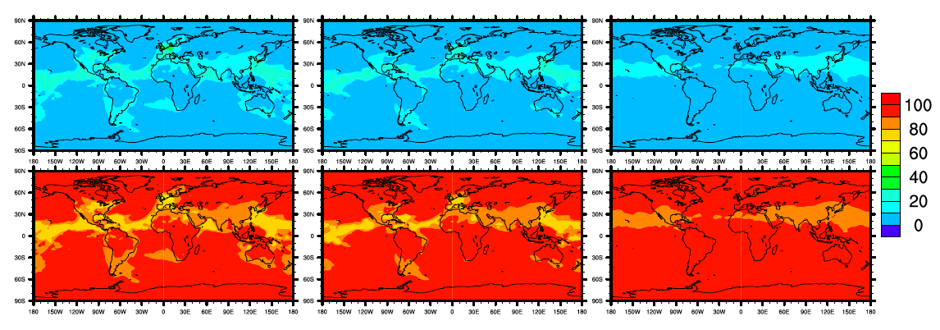
September
992hPa 859hPa 524hPa
BC
OC
Volume fraction (%)

Slide 14
Schematic of aerosol modes and associated tracers in MAM4
The equivalent of 8-monolayers of sulfate is needed to transfer material from the primary carbon mode (fresh) into the accumulation mode (aged).
aitken
accumulation
coarse
MAM4 | σ_{g} | Size range (μm)
Aitken | 1.6 | 0.015-0.053
Accumulation | 1.8 | 0.058-0.27
Primary carbon | 1.6 | 0.039-0.13
Coarse | 1.8 | 0.80-3.65
Coagulation
Condensation
(Liu et al., 2015)
Primary carbon mode
Notes:
A 4-mode version of the modal aerosol model (MAM4) is applied in CAMChem1.2.2. BC is emitted to the primary carbon mode, and then is aged and transferred to the accumulation mode by condensation of $\rm{H_2SO_4}$, $\rm{NH_3}$ and $\rm{SOA}$ and by coagulation (Liu et al., 2012).

Slide 15
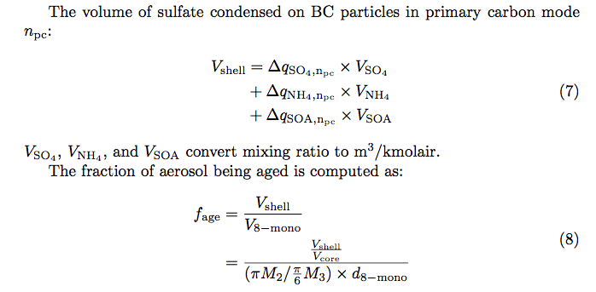
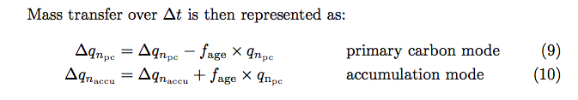
Condensation Scheme
Shell
BC
Sulfate

Slide 16
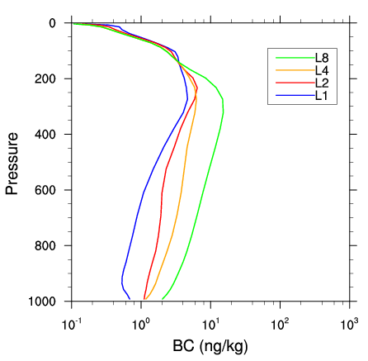
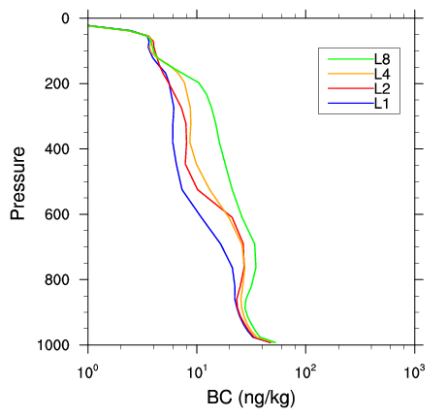
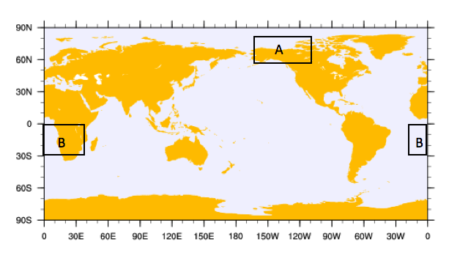
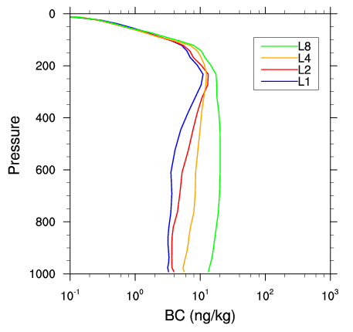
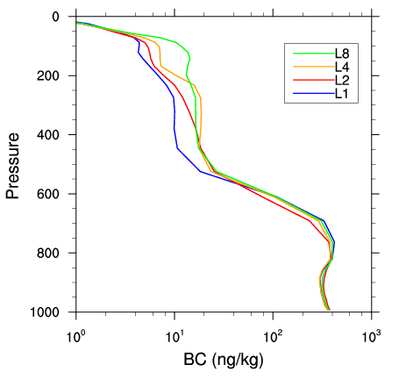
Sensitivity to Number of Monolayers
Region A Region B
March
September
1 monolayer – L1
2 monolayers – L2
4 monolayers – L4
8 monolayers – L8
Notes:
Figure out the initial condition and water uptake!

Slide 17
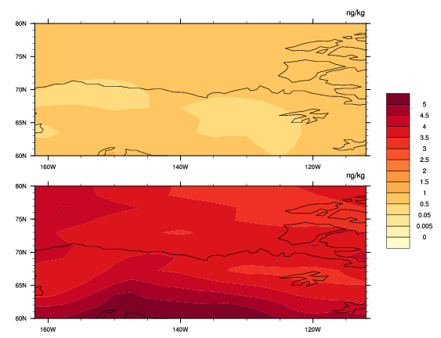
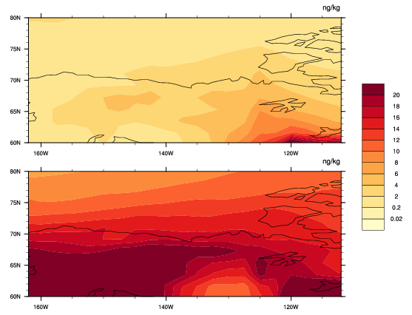
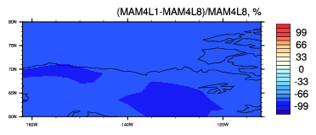
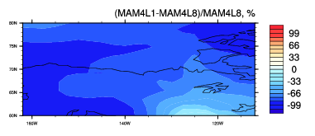
Region A - 859hPa
March
September
L1
L8
Relative
Differences
(L1-L8)/L8

Slide 18
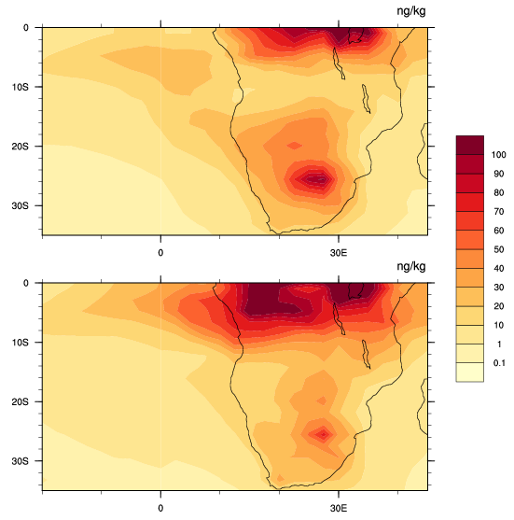
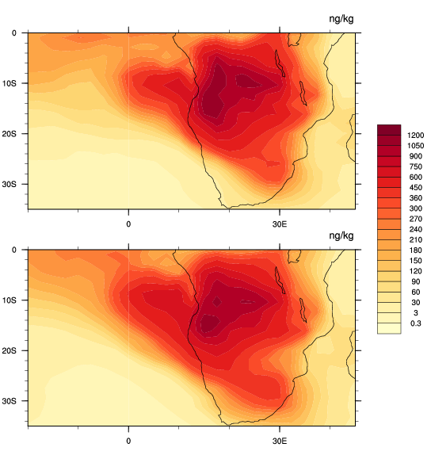
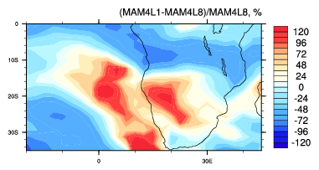
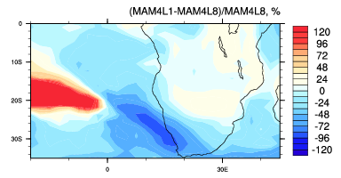
Region B - 859hPa
March
September
L1
L8
Relative
Differences
(L1-L8)/L8

Slide 19
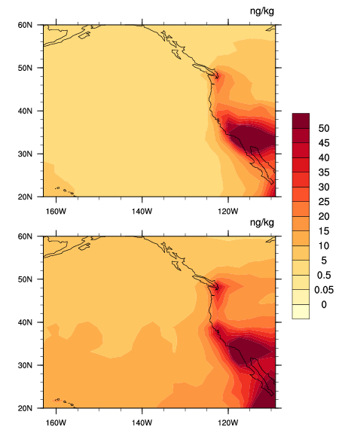
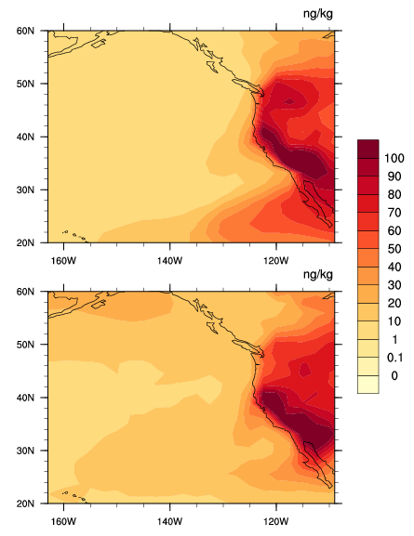
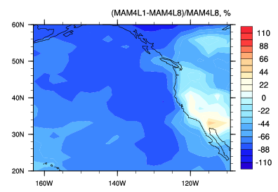
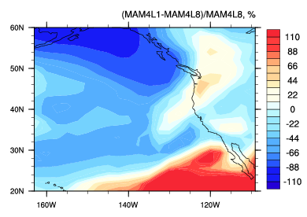
Region C - 859hPa
March
September
L1
L8
Relative
Differences
(L1-L8)/L8

Slide 20
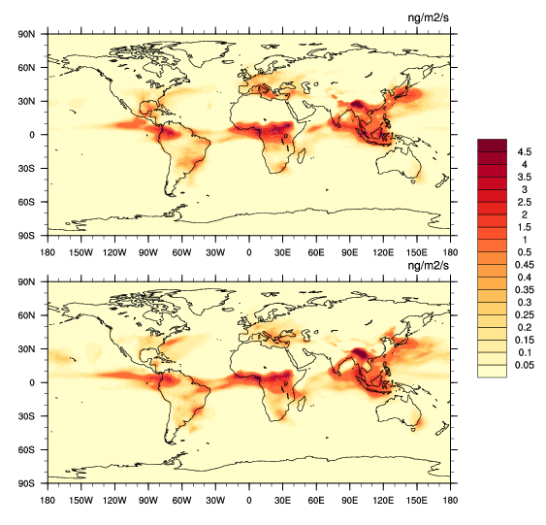
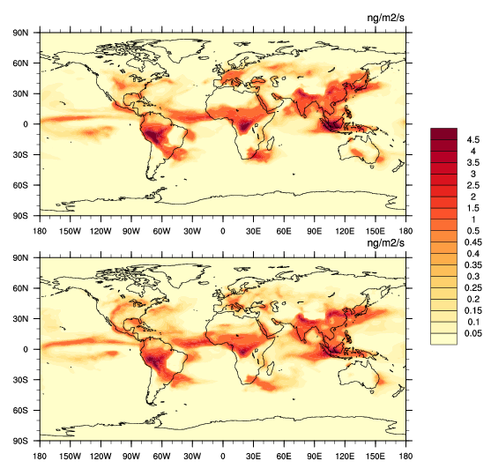
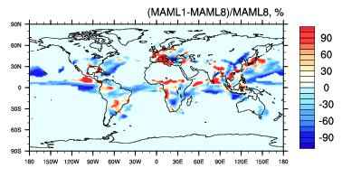
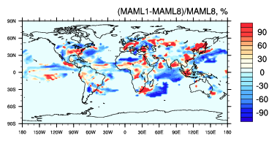
BC Wet Deposition Flux
March
September
L1
L8
Relative
Differences
(L1-L8)/L8

Slide 21
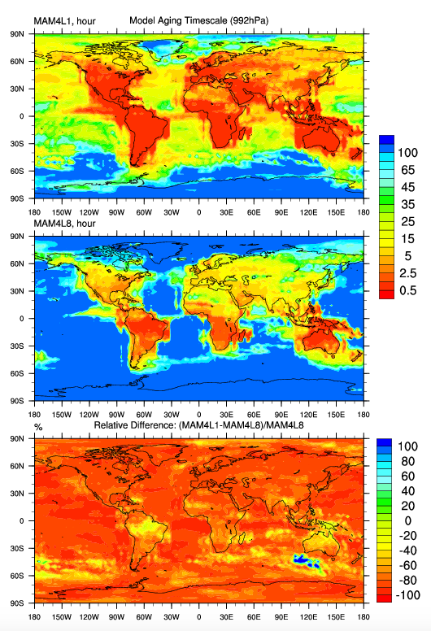
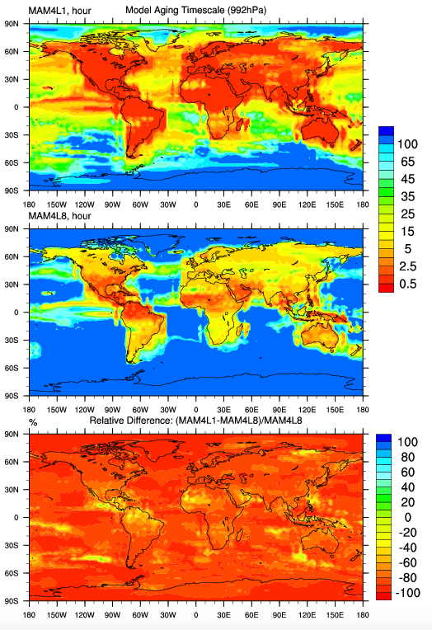
Monolayer Impact on Aging Timescales
March September
L1
L8
(hour)
(hour)
Relative
Differences
(L1-L8)/L8
(%)
(%)

Slide 22
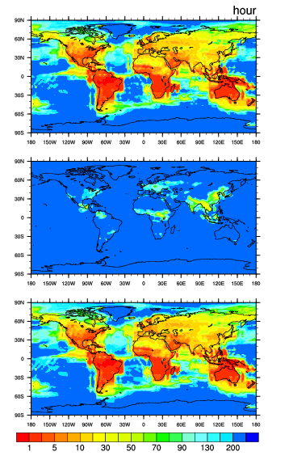
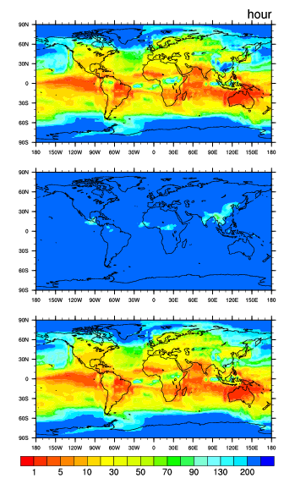
Contribution from Condensation and Coagulation
992hPa 859hPa
Condensation
Coagulation
Overall
Condensation plays a dominating role.
Aging timescales range from less than one hour to several days.

Slide 23
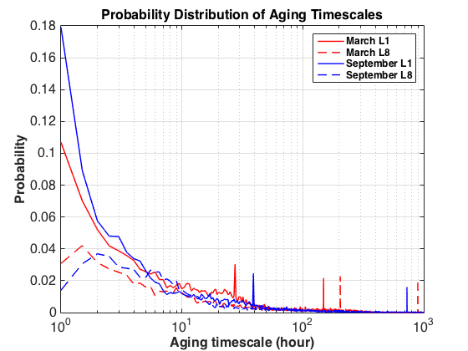



Pdf of Aging Timescales
Global
Region A
Region B
Region C

Slide 24
Comparison of Aging Timescales between Model and Laura’s Parameterization
According to Laura’s research, the e-folding timescale of BC aging is given by:
condensation coagulation
I_{cond}: total volumn condensation rate over surface area
N: total aerosol number concentration

Slide 25




Condensation Volume Rate over Surface Area
March September
992hPa
859hPa

Slide 26

Condensation Volume Rate over Surface Area
Non-reversible reversible

Slide 27


Aging Timescales for March
Model Laura’s Parameterization
992hPa
859hPa
(hour)

Slide 28
Conclusions and Next Steps
Conclusions:
CAMChem model runs successfully.
Simulated BC concentrations are sensitive to choices of aging criterion.
Process analysis of BC aging.
Condensation of SOA and sulfate plays a dominating role.
Aging timescales range from less than one hour to several days.
MAM4 aging timescales broadly consistent with PartMC MOSAIC aging timescales.
Next Steps:
Use offline meteorology/nudging.
Quantify the differences between MAM4 aging timescales and PartMC aging timescales.
Process analysis of BC vertical distribution.
Notes:
Large discrepancies in the upper level compared with HIPPO. We need to figure out what processes contribute that differences.

